Slide 1
Workshop GUI
Introduction to:
Graphical User Interface
(Graphical User Interface = GUI)

Slide 2
Adding a GUI To Your Project
Monday 18th
Eclipse & Window Builder (plug-in to Eclipse)
GUI Intro:
Building a GUI
Components (containers)
Event handling
Layout
Tuesday 19th
More GUI Topics
Until the test-exam
Work on your project – adding GUI

Slide 3
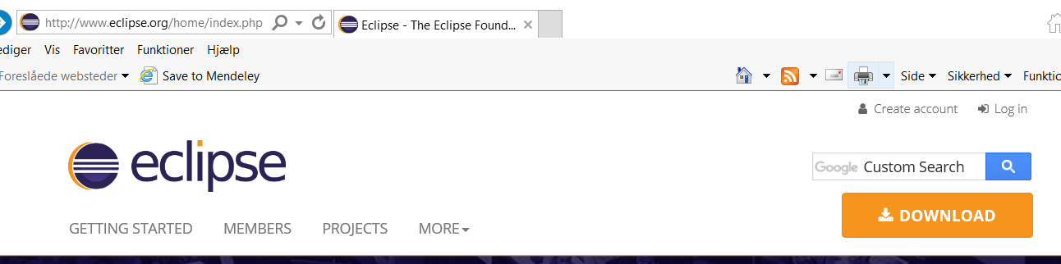
Lets start with installing Eclipse
Go to eclipse.org
Select download button

Slide 4

Eclipse ctd
Now select “download packages”

Slide 5
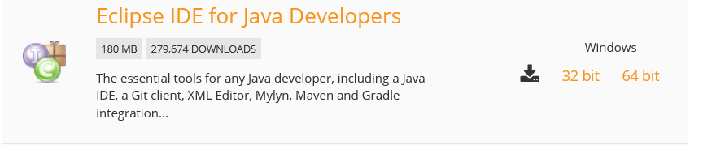
Final step
Select Eclipse for Java developers (64 bit)
Unzip to a convenient location and create a shortcut to the program

Slide 6

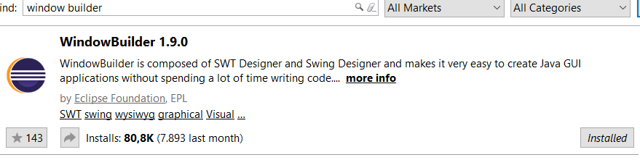
Window Builder
Used to create GUI in Swing/AWT
Installed via Eclipse Marketplace

Slide 7
How does a program with GUI work?
GUIs are (also) built from interacting objects (components)
Placement of components = Layout
Programs with a graphical user interface (GUI) are event-driven:
the program reacts to events from the user
A program with a graphical user-interface has:
a phase where graphical objects are created and shown on screen.
a phase where the ”event handling” has the control
a phase where the event is acted upon

Slide 8
GUI-elements
Components:
GUI building blocks
Examples of components:
Buttons, Menus, Scroll panes, Panels, Text fields, etc.
Components are classes
Event-handling:
Reactions to the actions of the user
Examples of events:
Click on a button
move the mouse
Choose an item in a menu
Etc.
Layout:
Placement of the components in a sensible way
use layout managers

Slide 9
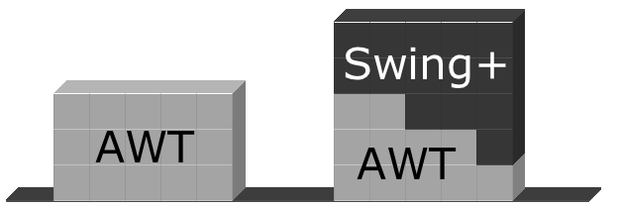
AWT and Swing
AWT: Abstract Window Toolkit
“old-time”-library
Swing:
new and better library

Slide 10
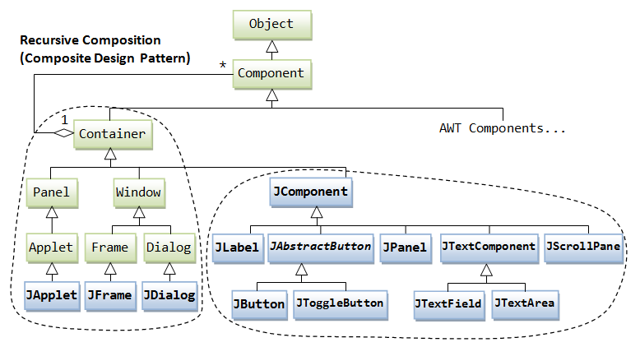
Class hierarchy of the swing GUI classes
SOURCE: https://www3.ntu.edu.sg/home/ehchua/programming/java/J4a_GUI.html

Slide 11
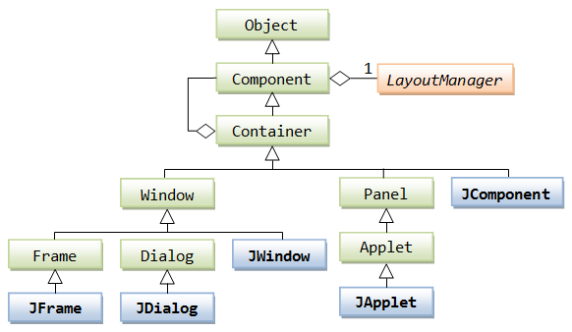
Class hierarchy of Swing
SOURCE: https://www3.ntu.edu.sg/home/ehchua/programming/java/J4a_GUI_2.html

Slide 12
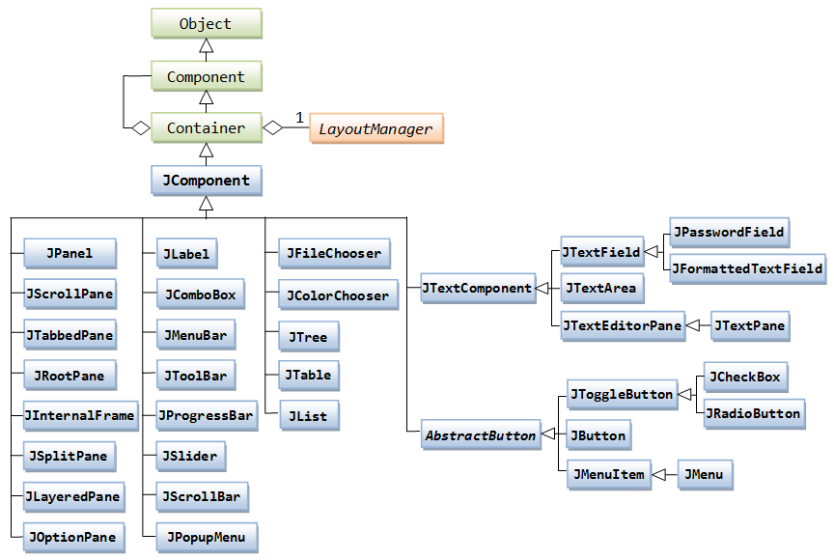
Class hierarchy of Swing
SOURCE: https://www3.ntu.edu.sg/home/ehchua/programming/java/J4a_GUI_2.html

Slide 13
Hello, World
Event handling:
ActionListener
Anonymous Inner Classes
Components:
JTextField, Jbutton
Null-layout (just used for simplicity here)

Slide 14
Event handling
An event is what happens when a user interacts with a component
Each component is associated with certain events
Frames are associated with WindowEvent (handled by the operating system)
Menues are associated with ActionEvents
Etc.
Objects, which must know of events must be listeners.
All GUI-objects can be listeners, they just have to implement an interface

Slide 15
Event handling
Listeners belonging to
the component
react to the event
User interface
GUI-Component fires an event
when a user interacts
Java-code
Does the dedicated work

Slide 16
Events – some of them…
Component | Event | Interaction
JButton | ActionEvent | The user presses a button
JCheckBox | ItemEvent | The user has checked in a checkbox
JCheckboxMenuItem | ItemEvent | The user has marked a checkbox list
JPopupMenu | ItemEvent | The user has chosen a menu item
JComponent | ComponentEvent FocusEvent KeyEvent MouseEvent | The component has been moved or has changed size. The component has gotten or lost focus The user has pressed a key The user has done something with the mouse
JContainer | ContainerEvent | A component has been added/removed from the container
JList | ActionEvent ItemEvent | The user has double-clicked an element The user has clicked an element
JMenu | ActionEvent | The user has chosen a menu item
JScrollbar | AdjustmentEvent | The user has moved the scrollbar
JTextComponent | TextEvent | The user has changed the text
JTextField | ActionEvent | The user has pressed ENTER

Slide 17
Inner Class
Class definitions can be nested or inner:
public class Enclosing { … private class Inner { … } }

Slide 18
Inner Classes
Inner classes are in the scope of the outer class
Instances of the inner class exist within the instance of the outer class.
Members of the inner class can see and access private members of the outer class
This is also true for local variables within the method where the inner class is defined, be wary of this as the variable may not exist when it is used by the inner class

Slide 19
Anonymous inner classes
Are inner classes, but has no name
Are used to create instances, where a class name is not nescessary
Has a special syntax
The object always references its static type, since the dynamic type (the sub type) has no name.

Slide 20
Anonymous ActionListener
JMenuItem openItem = new JMenuItem("Open");
openItem.addActionListener(new ActionListener(){
public void actionPerformed(ActionEvent e) {
openFile();
}
});
Static type is
ActionListener
Register a listener
The dynamic type is anonymous, but implements the
ActionListener-interface.
This means the method actionPerformed()

Slide 21
Layout managers
Used for controlling the “placement” of containers
FlowLayout, BorderLayout, GridLayout, BoxLayout, GridBagLayout.
Containers of objects
for instance “content pane”.
Every manager has its own style.

Slide 22

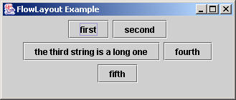
FlowLayout

Slide 23
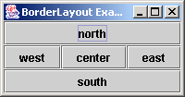
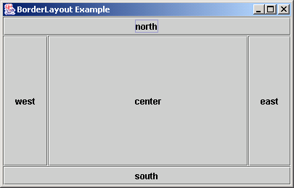
BorderLayout

Slide 24
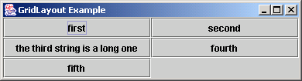
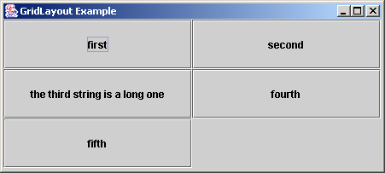
GridLayout

Slide 25
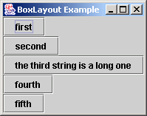
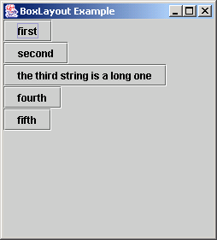
BoxLayout
Note: no component
resizing.

Slide 26
Nested containers
Layout is built up of containers with containers in them - much used is the Jpanel
Also the JScrollPane is handy
Every container has it own layout manager
Which you pick
JFrame and JDialog are top level containers, they cannot be within other container
JDialog can be modal

Slide 27
Container with container
JPanel
JPanel
JPanel
JFrame
JPanel

Slide 28
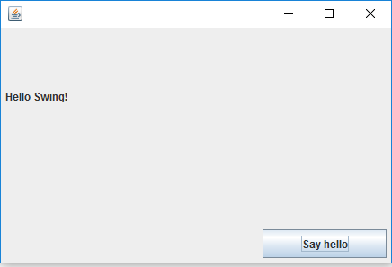
Exercise
Make a Hello, World! application using Swing
When you click the ”Say Hello” button, the window should display the text ”Hello, Swing!” in a JLabel

Slide 29
Dialog boxes
Modal dialogs - blocks all other interaction.
forces the user to interact
Non-modal dialogs allow other interaction
can be used, but inconsistency can become an issue.

Slide 30
Input-output
JTextField
JOptionPane

Slide 31
Reading from JTextField
private void buildNameobject() {
String firstName = txtFirstName.getText();
String lastName = txtLastName.getText();
//read numbers from the screen
int nr = Integer.parseInt(txtNo.getText());
clearScreen();
}
Convert into int

Slide 32
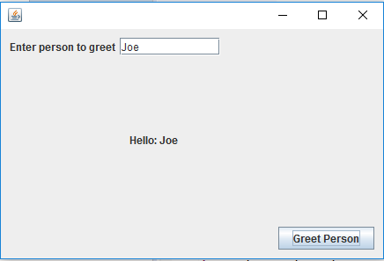
Exercise
Make an application that takes a text input from a JTextField and displays a message, which includes that input

Slide 33
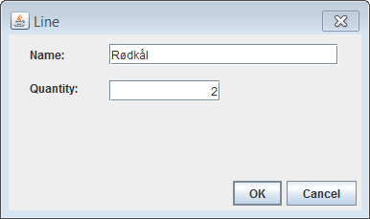
Object view
Show a model layer object
Here:
Grocery List Line (Line)
Name (of grocery)
Quantity
These correspond to attributes
OK can be understood in the context it was invoked (we clicked the ”New” button),
Or we could name it ”Save” or ”Add” to make it more intuitive (”Don’t make me think”)
Often, these views, when stand-alone, are impelemented as modal dialogs

Slide 34
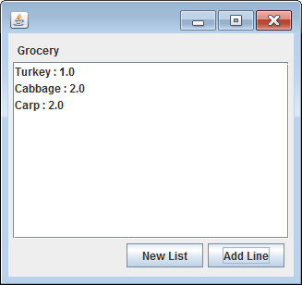
List View
Show multiple objects in a list (or table)
Logically corresponds to a container (or search results)
Usually, you have functions corresponding to CRUD

Slide 35
Exercise
Take the GroceryList2_Headless project (it has a controller and a model layer), and write a GUI for it
You should be able to see all the stuff you want to buy in a list (List view)
You should be able to add lines to the list (Object view)

Slide 36
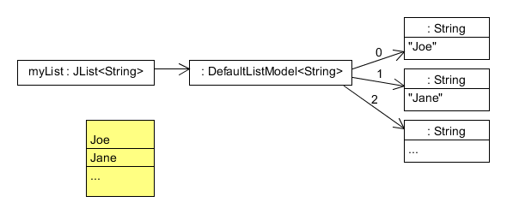
JList
Add a JList to your GUI
Type parameter
Add DefaultListModel
Same type parameter
Add values to the DefaultListModel
How to control the drawing of elements in the JList?
Implement a ListCellRenderer

Slide 37
ListCellRenderer
The class is used to render each cell in the Jlist
We have to implement it
The example just uses a String as model object
public class SomeCellRenderer implements ListCellRenderer<String> {
@Override
public Component getListCellRendererComponent(JList<? extends String> list,
String item, int index, boolean isSelected, boolean cellHasFocus) {
JLabel label = new JLabel();
label.setText(item);
label.setOpaque(true); // support selection (7 LOC)
if(isSelected) {
label.setBackground(list.getSelectionBackground());
label.setForeground(list.getSelectionForeground());
} else {
label.setBackground(list.getBackground());
label.setForeground(list.getForeground());
}
return label;
}
}

